Slide 1
Learning Objectives
You should be able to:
  Define and recognize scalars, vectors, and tensors.
  Describe the difference between continuum and statistical mechanics, the advantages and disadvantages of each, and their applications
  Understand and perform standard vector and tensor mathematical operations
  Define the material derivative and use it to convert between spatial and material coordinates and to describe motion in engineering problems
  Define, calculate, and use pathlines, streamlines, and streaklines for a given flow

Slide 2
Motivating Question
You wish to generate a CAD model of an arterial bifurcation, which you represent as the union of two cylinders.
How do you describe the horizontal cylinder mathematically?
How do you describe the diagonal cylinder mathematically?

Slide 3
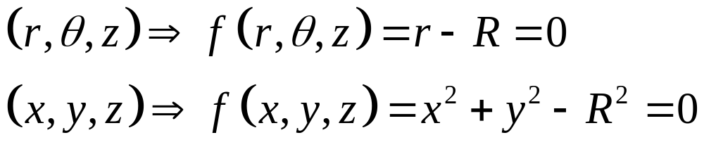
Motivating Question
How do you describe the horizontal cylinder mathematically?
It depends on the coordinate system you choose.

Slide 4
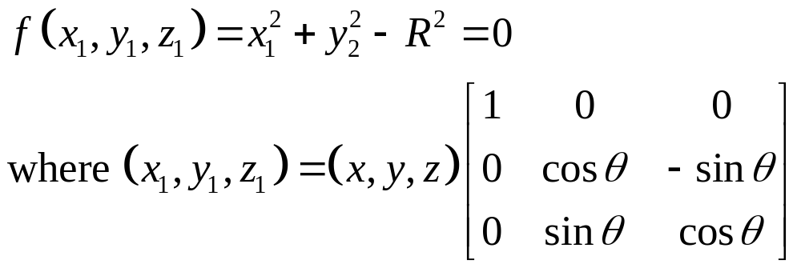
Motivating Question
How do you describe the diagonal cylinder mathematically?
You have already done it for the horizontal cylinder. If you were to choose a coordinate system for which the axis is aligned with the z-coordinate, you just need to rotate:

Slide 5
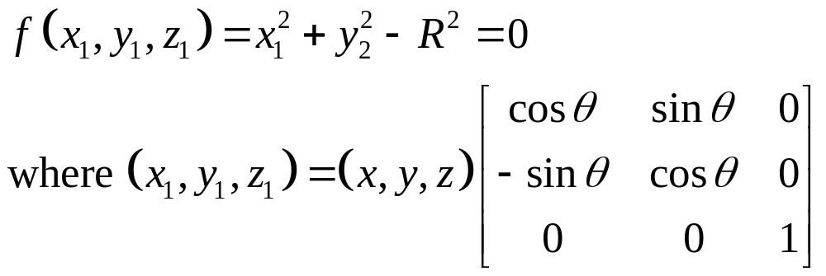
Motivating Question
vector
Rotation matrix (tensor)
This set of equations looks complicated, but you will not need to worry about the details. The software you use will take care of the tedious calculations.

Slide 6
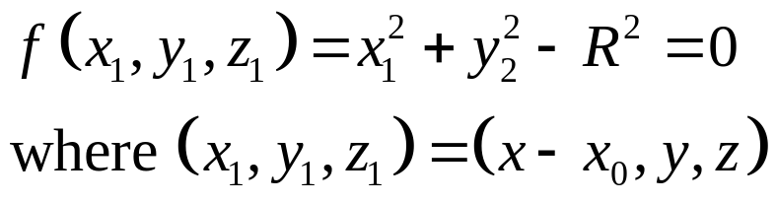
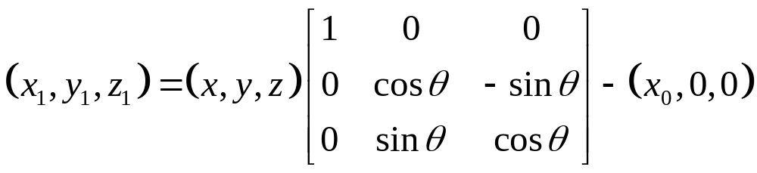
Motivating Question
If you wanted to shift the cylinder in the x-direction, you would do something like this:
And if you wanted to rotate and then shift:

Slide 7
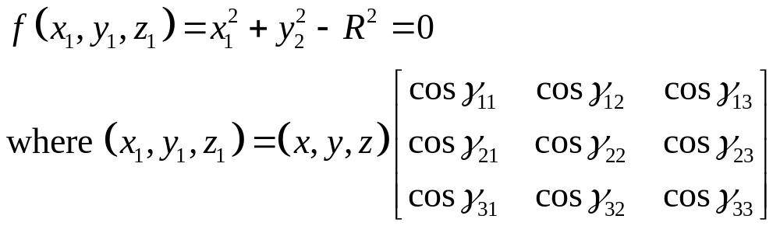
Motivating Question
If you wanted a more general rotation:
Where γ_{ij} is the angle through which the i-axis in the original coordinate system must rotate to align with the j-axis in the new coordinate system.

Slide 8
Axis Rotation
2
1
3

Slide 9
Axis Rotation
2
2
1
γ₁₂
γ₁₁
γ₁₃
1
3
3

Slide 10
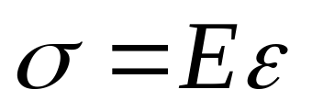
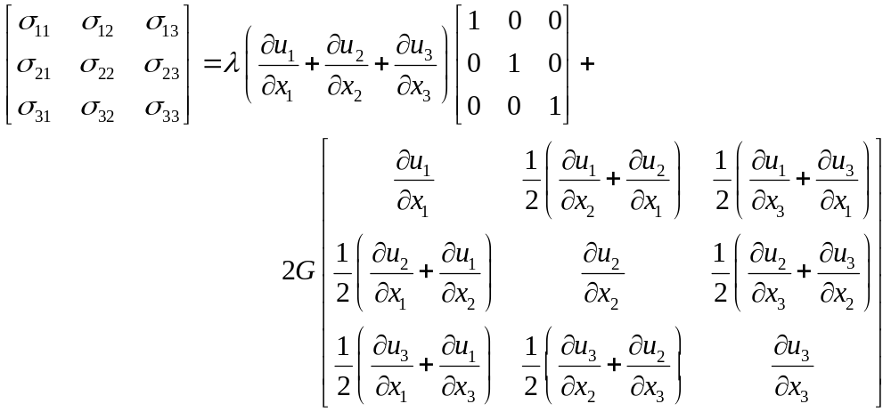
Purpose of the Stress Tensor
For solids:
One dimensional
Three-Dimensional, where u is displacement

Slide 11
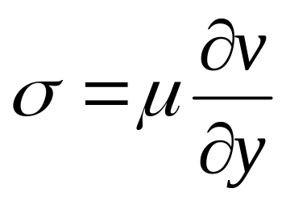
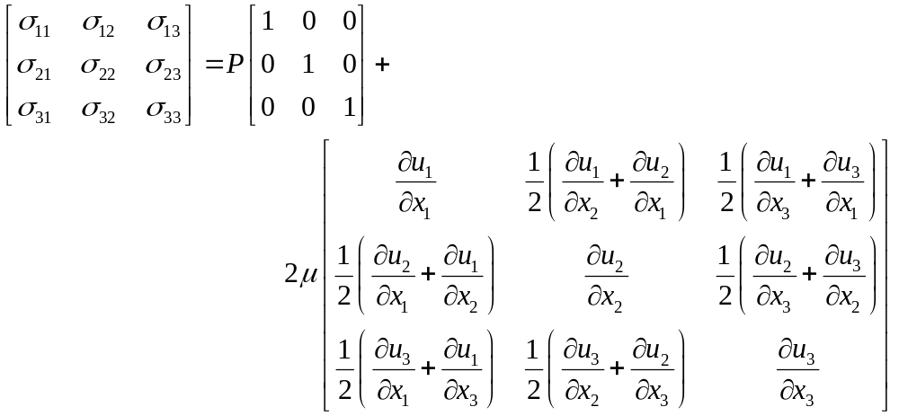
Purpose of the Stress Tensor
For fluids:
One dimensional
Three-Dimensional, where u is velocity

Slide 12
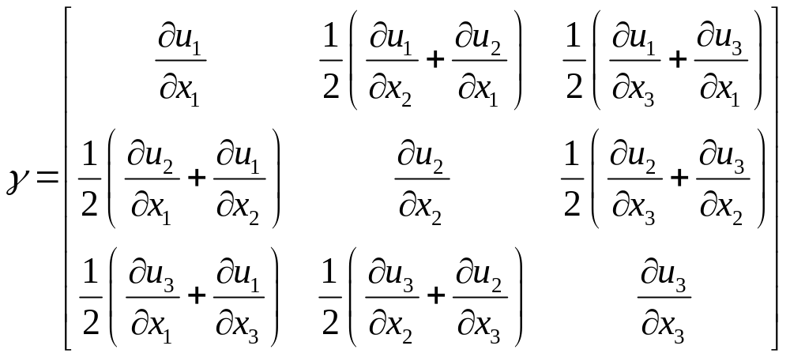
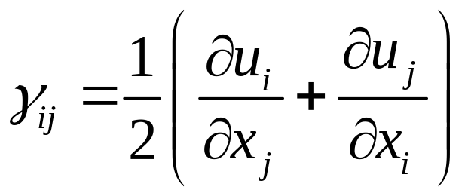
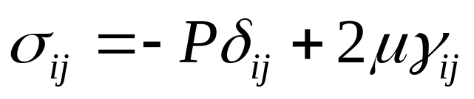
Tensor Notation
Is called the rate of strain tensor. It can be written more simply (in tensor notation) as:
and

Slide 13
Scalars, Vectors, and Tensors
A Scalar
  Has magnitude only (e.g. T=temperature)
  Represented by a single number
A Scalar Field
  A scalar as function of position (e.g. T=T(x,y,z))
  Represented by a single number whose value varies in space.
A Vector
  Characterized by a magnitude and direction (e.g. v=velocity)
  Represented by a set of numbers (e.g. in 3 dimensions 3 numbers)
  Represented as an arrow with length and spatial orientation
  Two vectors are said to be equal if they are Parallel (Pointed in same direction) and of equal length (magnitude).
A Vector Field
  A vector whose magnitude and direction vary in space (e.g. v=v(x,y,z)).
z
x
y
Two Equal Vectors

Slide 14
Familiar Position and Spatial Vectors
In calculating torque, a force will be applied at a point in space.
  The force itself is the spatial vector
  The point of application is the position vector
y
F
p
x
z

Slide 15


Scalars, Vectors, and Tensors
Vectors cont.
  Independent of coordinate system
  Spatial vectors vs. position vectors
    Consider the velocity field v(x,y,z).
    The vector p=(x₀, y₀, z₀) is a position vector, representing a location in space.
    The velocity vector at that location is a spatial vector, v(x₀ , y₀ , z₀)
z
z
φ
x
r
r
θ
θ
y
z
x
y

Slide 16
Scalars, Vectors, and Tensors
A tensor
  Characterized by an order.
  In general then:
    Zeroth-order tensor is a scalar
    First-order tensor is a vector
    Second order tensor looks like a 3x3 matrix.
  An n^{th} order tensor has 3^{n} components
  Usually, “tensor” refers to a second order tensor
    Ordered set of nine numbers, each of which is associated with two directions
    “Arrow-in-space” concept not helpful
    Stress tensor a common example in fluid mechanics

Slide 17

Scalars, Vectors, and Tensors
Notation
  Gibbs notation
    After J.W. Gibbs who developed most of basic theory of chemical thermodynamics
    Scalars: italic Roman letters (e.g. f)
    Vectors: boldface Roman letters (e.g. v)
    Tensors: boldface Greek letters (e.g. τ)
    Magnitude of vectors and tensors
      Use corresponding italic letter
      May also use absolute value sign for clarity
    Unit vectors of correspond coordinate systems: e_{i}, where subscript is coordinate
    Advantage: most equations can be written in a simple and general form without reference to a particular coordinate system

Slide 18
Basis Vectors
The basis vector is the vector pointing in the direction of increase of one of the coordinate variables at a given location in space.
What is the basis vector for the r-direction for cylindrical coordinates at the location (r, θ, z) = (1,π/4,3)?

Slide 19
Orthogonal Coordinates
j
i
k
e_{θ}
e_{r}
e_{z}

Slide 20

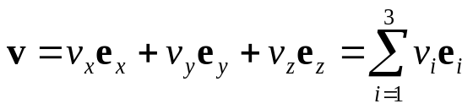
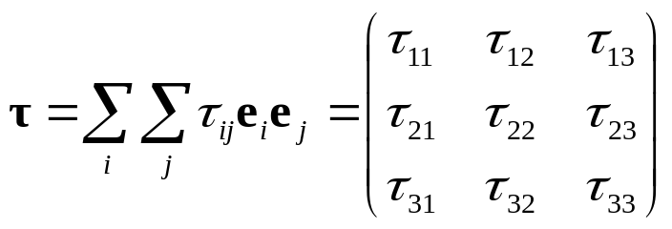
Scalars, Vectors, and Tensors
Cartesian tensor notation
  Based on vector and tensor components, which are identified explicitly using subscripts
  Advantage: show results of vector and tensor manipulations more explicitly
  Disadvantage: component representations of differential operators only valid for rectangular coordinates
  A vector v is represented:
    (e_{x}, e_{y}, e_{z}) are unit vectors in x, y, and z directions respectively, (v_{x}, v_{y}, v_{z}) are corresponding scalar components of v.
    Labeling coordinates (1, 2, 3) instead of (x, y, z) give more compact summation notation shown.
  A tensor τ is represented:
    Each scalar component is associated with a pair of unit vectors, e_{i}e_{j}, called a unit dyad
Einstein notation: leaves off the summation sign (Σ)

Slide 21
Question:
Consider liquid in a beaker. The molecules are continually in motion, but the fluid appears to be still. You want to quantify the lack of motion of the fluid (e.g. non-swirling vs. swirling) and you want to have a functional description of the net motion at a given point. As your point becomes smaller and smaller, how do you handle it in a physically meaningful manner?
In the same beaker, what is the meaning of “instantaneous” flow velocity?

Slide 22
Lagrangian Viewpoint
Mass point mechanics cont.
    If a particle is in motion, it has a trajectory defined by the position vector z
      Function of time
      Describes position history of particle
    Ordinary derivative of z with respect to time gives the velocity of the particle
      Vector tangent to trajectory
z
z(t)
v(t)
x
y

Slide 23
Lagrangian Viewpoint
For an integer number of particles n,
  We can define the trajectories and velocities of each particle
    Using a superscript: z^{(n)}= z^{(n)}(t); v^{(n)}=v^{(n)}(t)
    Alternatively: z= z(t,n); v=v(t,n)
  Great for particle mechanics
  For a continuum, integers are insufficient (we have an uncountable number of particles)
We need a continuous identification of variables for continuum mechanics

Slide 24


Exercise
Consider the flow configuration below:
The velocity at the left must be smaller than the velocity in the middle.
What is the relationship?
If the flow is steady, is v(t) at any point in the flow a function of time?

Slide 25

Exercise
Consider the flow configuration below:
Assume that along the red line:
a. What is the velocity at x = -1 and x = 0?
b. Does fluid need to accelerate as it goes to x = 0?
c. How would you calculate the acceleration at x = -0.5?
d. How would you calculate acceleration for the more general case v = f(x)?
e. Can you say that acceleration is a = dv/dt?

Slide 26
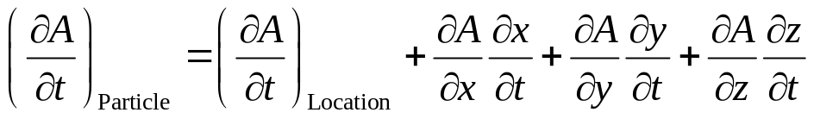
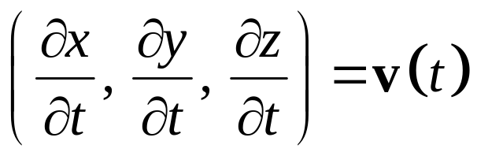
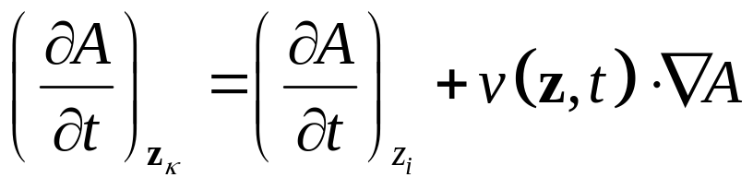
Relationship between Lagrangian and Eulerian Descriptions
If A is a property of something passing through a point in space, but we know only the rate of change of that property with time at that point in space, then:
For a given particle
For a point in space
But:
So:
Material (Lagrangian)
Spatial (Eulerian)

Slide 27
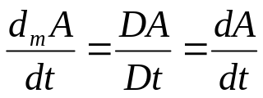
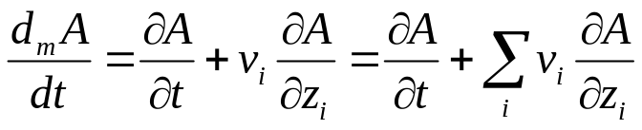
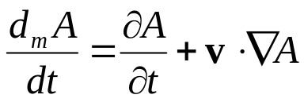
Kinematics
The material derivative is also know as:
  Substantial derivative (since relative to a particle of a substance)
  Stokes derivative (after the 19th century Irish/English scientist)
The material derivative is expressed several ways, including:
  The first one is used in your book, so we’ll use it here
  Sometimes you will see material variables in capital letters (A) and spatial variables in lower case letters (a)
Now we can drop the subscripts since we know what’s being held constant on each side of the equation giving
  In Cartesian vector notation form:
  In Gibbs notation form:

Slide 28

Kinematics
Before we move on, let’s look at the physical meaning of the terms in the material derivative…
Textbook example (pp. 4-5) concentration of fish in the water as you look out from a boat if:
1.) the boat is anchored (stationary)
2.) the boat is drifting with the river current (fluid flow)
3.) the boat is traveling in an arbitrary path with velocity v_{(b)} in the river
Time rate of change of A at a fixed point in space (the local derivative)
Time rate of change of A following the material
Time rate of change of A due to movement of the fluid (the convective derivative)

Slide 29
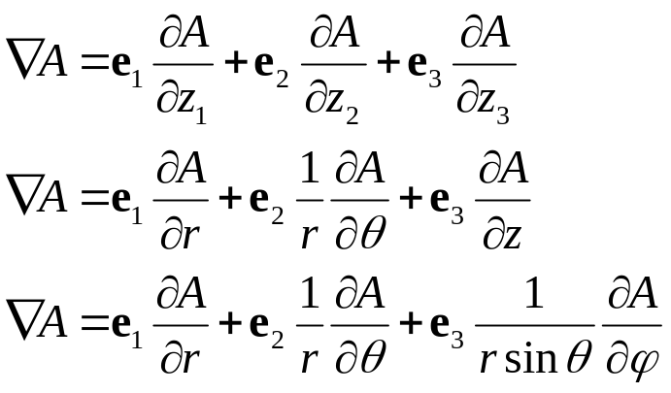
Vector and Tensor Analysis
In the material derivative in Gibbs notation, we introduced some new mathematical operators
Gradient
  In Cartesian, cylindrical, and spherical coordinates respectively:
What is this operation?

Slide 30








Vector and Tensor Analysis
Some other rules for vector operations
  Vector addition
    Graphically, addition of two spatial vectors (v+w) can be represented using the parallelogram rule (see Fig. A.1.1-1)
    Rules:
      A₁:
      A₂:
      A₃:
      A₄:
        Note: 0 is the zero spatial vector which has 0 magnitude and arbitrary direction
  Scalar multiplication
    Let α and β be real number scalars
    Vector αv has magnitude /α//v/
    Direction of αv is the same as that of v if α>0, opposite that of v is α<0
    Rules:
      M₁:
      M₂:
      M₃:
      M₄:
v+w
v+w
w
v
Any set of objects for which these rules hold is defined as a vector space
Elements of a vector space are referred to as vectors

Slide 31
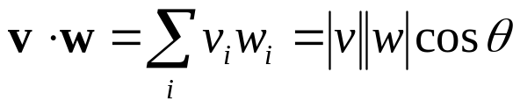



Vector and Tensor Analysis
  Inner product or dot product
    Expressed:
    Real number obtained by multiplying the length of two vectors and the cosine of the angle between them
    Rules:
      I₁:
      I₂:
      I₃:
      I₄:
Recommended Exercises:
A.1.1-1 and 2 (they’re pretty straight forward)
Any vector space for which the inner product satisfies these rules is an inner product space
By definition, the set of spatial vectors is an inner product space

Slide 32
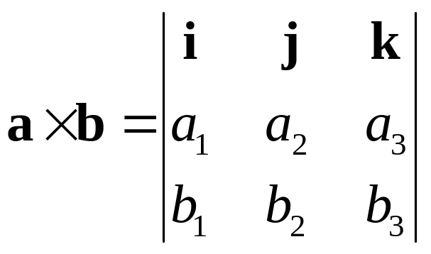
Cross Product
In Cartesian Coordiantes:
Used for:
  Moments
  Vorticity

Slide 33
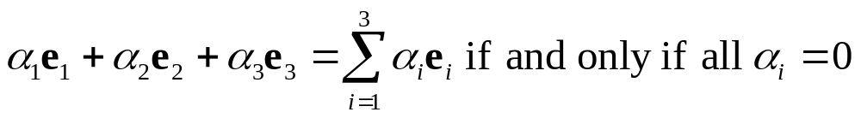
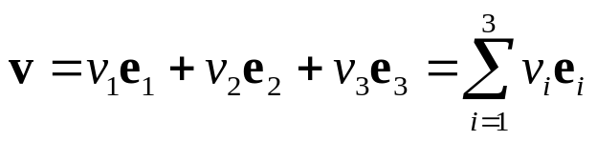
Vector and Tensor Analysis
Basis for a vector space
  Most common basis set: the unit vectors in Cartesian coordinates for the three spatial directions in Euclidian space, E₃
    Given in several forms, most common are: e₁, e₂, e₃ and i, j, k
  Other basis vectors are possible
  General characteristics:
    Basis vectors must be linearly independent, i.e.
    For vector space M, set of basis vectors χ is such that every vector v in M is a linear combination of elements of χ, i.e.
    While we most frequently deal with 3 dimensional space, you can have any finite n-dimensional space mathematically which will have n basis vectors satisfying the above conditions

Slide 34

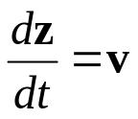
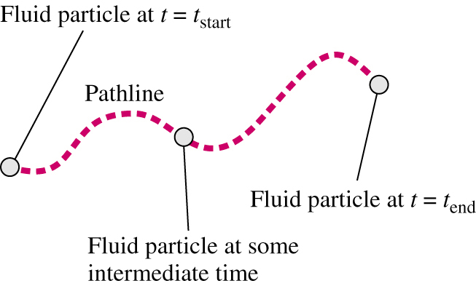
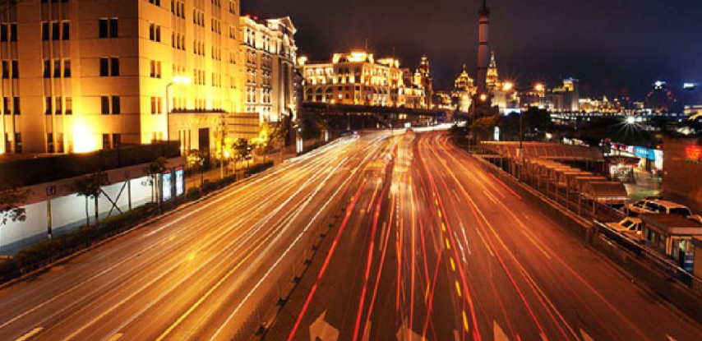
Flow Lines
Rarely can we predict flow with a simple calculation
  Flow visualization experiments used to study
  Four important flow lines
    Path line, Streakline, Timeline, and Streamline
    Let’s look at each…
Path line
  Curve in space along which the material particle ζ travels, mathematically:
  Mark a material particle and take a time lapse photo to get experimentally
  Can be calculated from a velocity distribution (velocity is the derivative with respect to time of the position)
Is this a Eulerian or Lagrangian measurement?
Lagrangian – you’re following a material particle

Slide 35
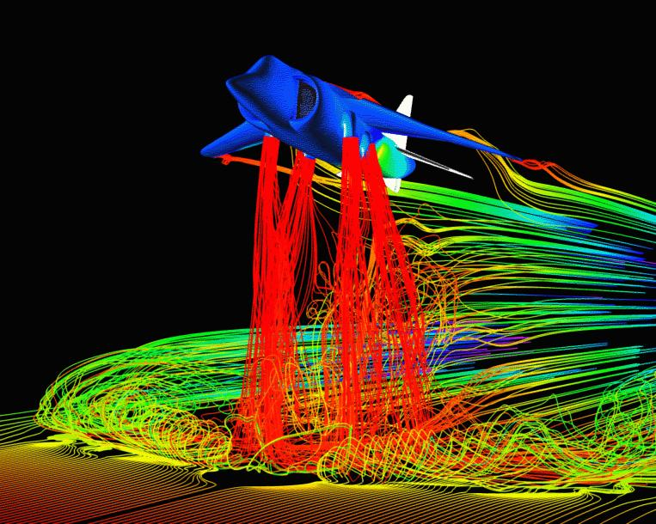
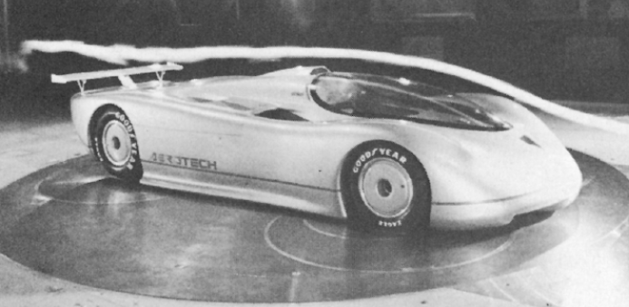
Flow Lines
Streakline
  Curve in space through z₍₀₎ representing the positions at time τ ≤ t have occupied the place z₍₀₎
  How would you experimentally get a streakline?
    Inject marker (dye, bubbles, smoke, etc.) at a given point in a flow
    Is this a Eulerian or Lagrangian method?
      Lagrangian – you’re following a material particle

Slide 36
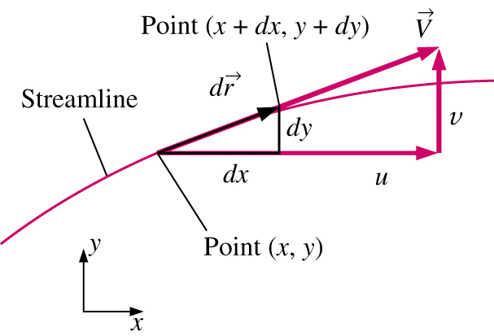
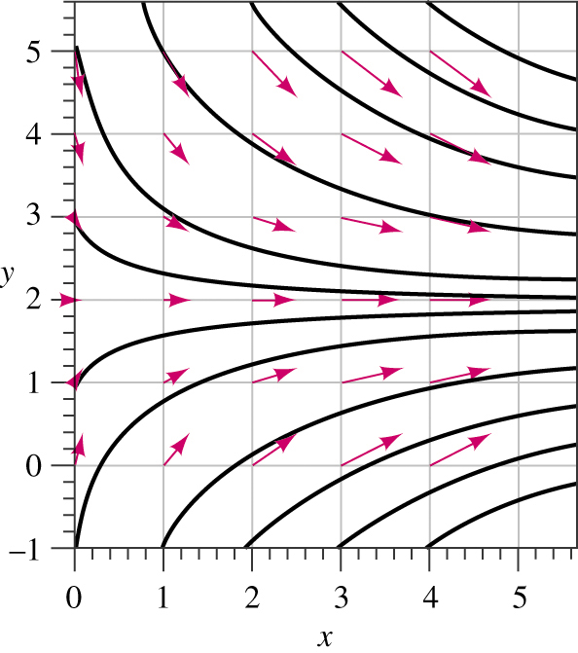
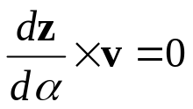
Flow Lines
Streamlines
  Family of curves for time t to which the velocity field is everywhere tangent at a fixed time t
  In other words: A Streamline is a curve that is everywhere tangent to the instantaneous local velocity vector.
  Gives an instantaneous picture of the flow field
  Can’t be measured in easy visual experiment
  May think of as the solution of the differential system of equations:
    Here a is a parameter with units of time and ^ represents a cross product (in most texts, × is used instead of ^)

Slide 37
Flow Lines
For steady flow, streamlines, pathlines, and streaklines are identical.
For unsteady flow, they can be very different.
  Streamlines are an instantaneous picture of the flow field
  Pathlines and Streaklines are flow patterns that have a time history associated with them.
  Streakline: instantaneous snapshot of a time-integrated flow pattern.
  Pathline: time-exposed flow path of an individual particle.

Slide 38
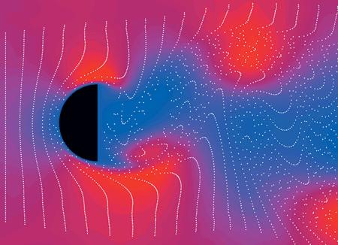
Flow Lines
Timeline
  Line formed as a number of adjacent fluid particles marked at a given instant in time move through a flow field

Slide 39
Homework Reminder
Requirements for the Overall Package
Assignment is submitted on 8 ½ x 11 paper.
Only one side of each page is used.
Problems are submitted in the order in which they were assigned.
All pages are stapled together in the upper left hand corner.
Margins are sufficient so that the stapling does not obscure writing.
Writing is neat and legible.
Language is appropriate and professional.
The work is not copied. While it may have been discussed with others, including other students and the instructors to the extent that an outline for the solution has been obtained in some cases, the student has taken the responsibility to translate that outline into the work on paper.
Louisiana Tech University
Ruston, LA 71272

Slide 40
Homework Reminder
Requirements for Each Problem
Each solution begins with a restatement of the problem in the student’s own words.
Credit is provided for ideas obtained from other sources.
Models, methods, key equations and/or assumptions are 1) identified and 2) explained in writing.
Algebraic manipulations are presented with enough detail so that the solution can be easily followed.
A box is placed around the numerical result(s) or mathematical expression(s) that constitutes the final answer for each problem.
Where appropriate, spreadsheets, graphs, computer programs or other output is included with the solutions and fully explained in writing.
A discussion of the solution is provided at the end of each problem.
Louisiana Tech University
Ruston, LA 71272

Slide 41
Homework Reminder
What are we expecting you to get out of your homework?
  An understanding of the concepts presented so you can synthesize your own knowledge and work from these concepts.
  An ability to communicate this synthesis in a clear, professional, and useful manner.
  Learning to ask the right questions and produce the right work to answer these questions.
Louisiana Tech University
Ruston, LA 71272

Slide 42
Homework Reminder
KEEP UP WITH THE WORK
  Fall behind even one assignment, and it can be difficult and, for some, impossible to recover.
  Be prepared to spend the adequate time on this work. Set aside 15-20 hours a week to work outside of class on this stuff.
  Come to the tutorials, come to office hours…ask questions, but don’t fall behind!
  This is all doable, but it’s up to you to get through it. We’ll give you the opportunities, you must take yourself through them.
Louisiana Tech University
Ruston, LA 71272

